Slide 1








1st GODEX-NWP (16th ~ 19nd May 2017)
KMA Report
: Satellite and data assimilation activities
Hyunjong Oh (hyunjong.oh@korea.kr)
Chu-Yong Chung (cychung0530@korea.kr)
Changhwan Kim (bluedu@korea.kr)
KMA

Slide 2


Contents
I. NWP & Data Assimilation Activities of KMA
II. Satellite Activities of KMA
III. Action Items related with KMA
IV. Announcement

Slide 3
NWP & Data Assimilation Activities

Slide 4
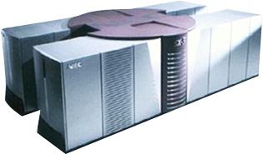
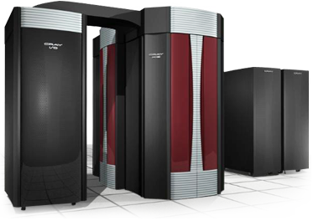

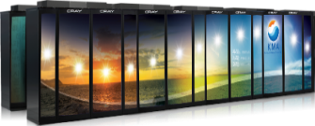
HPC
 | 1st Gen | 2nd Gen | 3rd Gen |  | 4th Gen
Operational Period | 1999~2005 | 2005~2010 | 2010~2015 |  | 2016~Current
System | NEC SX-5/28 | CRAY X1E | CRAY XE6 (AMD Magny-Cours) |  | CRAY XC40 (Intel Haswell)
Theoretical Performance (TFlops) | 0.224 (0.128 + 0.096) | 18.5 (9.75 × 2) | Interim | Final | Interim | Final
 |  |  | 37 | 758 (379 × 2) | 447 | 5,800 (2,900 × 2)
Numbers of CPU Cores | 28 (16 + 12) | 1,024 (512 × 2) | 3,392 | 90,240 (45,120 × 2) | 10,752 | 139,392 (69,696 × 2)
Memory(TB) | 0.224 | 4 | 7 | 60 × 2 | 57 | 372 × 2
Storage(TB) | 3.8 | 88 | 3,989 |  | 3,323 | 15,780
Resolution of Global Model | 55km | 30km | 25km |  | 17km(2016~) 12km(2019~, planed)
Notes:
5호기는 2019~2020년 도입 예정. 상세 사양은 미정.

Slide 5
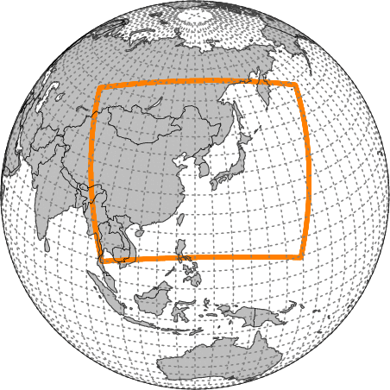
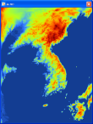
Operational Models
KMA’s operational models are based on Unified Model.
Global
Resolution
N768L70(UM)
(~17km / top = 80km)
Target Length
288hrs (00/12UTC)
87hrs (06/18UTC)
Initialization : Hybrid
Ensemble 4DVAR
Local
Resolution
1.5~4km L70(UM)
(1188×1148 / top=39km)
Target Length : 36hrs
Initialization : 3DVAR
Local EPS
Resolution
3km L70(UM)
(460×482 / top = 39km)
Target Length : 72hrs
Members : 12
Global EPS
Resolution
N400L70(UM)
(~32km/ top = 80km)
Target Length : 288hrs
Members : 49
Regional
Resolution
12kmL70(UM)
(0.11°x0.11° / top=80km)
Target Length : 87hrs
(6 hourly)
Initialization : 4DVAR

Slide 6
Data usage : conventional (2017. 5)
Data spices |  | Global | Regional | Local | Element
Surface | SYNOP | O | O | O | T, UV, RH, P, Vis | - Visibility data are assimilated for very short ranged LAM (2017.36)
 | BUOY | O | O | O | T, UV, RH, P, Vis
 | SHIP | O | O | O | T, UV, RH, P, Vis
 | METAR | O | O | O | T, UV, RH, P
 | AWS, AMEDAS |  | O | O | T, UV, RH | - Hourly data
Upper Air | Sonde | O | O | O | T, UV, RH | - preparing for HR Sonde and observation in descending phase(2017)
 | Dropsonde | O | O |  | T, UV, RH
 | PILOT Balloon | O | O | O | UV
 | Wind Profiler | O | O | O | UV | - Hourly data - Research for utilization of QC flag(2017)
Aircraft | AMDAR | O | O | O | T, UV
 | AIREP | O | O | O | T, UV
TC Bogus |  | O | O | O | MSLP

Slide 7
Data usage : satellite (2017. 5)
Data spices |  | Global | Regional | Local | Element
ASCAT |  | O | O | O | UV | Coastal wind 12.5/25km(OSI-SAF)
AMV | Meteosat-7 | O | O |  | UV | ~2017.4(discontinued)
 | Meteosat-8 | O |  |  |  | 2017.4~
 | Meteosat-10 | O
 | GOES-E/W | O
 | Polarwind | O | O
 | Himawari-8 | O | O |  |  | 2016.3~
 | COMS | O | O
 | LEOGEO | Planed | Planed
ATOVS | AMSU, HIRS | O | O |  | Radiance | NOAA-15/18/19, Metop-A/B
IASI |  | O | O | Planed | Radiance | 314 channels, Global & direct read out
ATMS |  | O |  | Planed | Radiance
CrIS |  | O |  | Planed | Radiance

Slide 8
Data usage : satellite (2017. 5)
Data spices |  | Global | Regional | Local | Element
AIRS |  | O | O |  | Radiance | AQUA
GNSS RO | COSMIC 1~6 | O | O | Planed | banding angle
 | Metop-A/B | O | O | Planed
 | TanDem-X TerraSAR-X Grace-B | Planed |  | Planed
 | KOMPSAT-5 | Planed |  | Planed
CSR | COMS | O |  | Planed | Radiance
 | Meteosat-7 | O |  |  | Radiance | ~2017.4(discontinued)
 | Meteosat-8 | O |  |  | Radiance | 2017.5~
 | Meteosat-10 | O |  |  | Radiance
 | GEOS-E/W | O |  |  | Radiance
 | Himawari-8 | Planed |  | Planed | Radiance | Planed(2017.10~)
Ground based GNSS |  | O |  | Planed (2017.6) | ZTD
Rader |  |  |  | O | UV

Slide 9
Changes(2015.10~2017. 5) and Plan
Changes
Model upgrade(2016.6)
  Major upgrade for global/local NWP
  added ATMS, CrIS, CSR(SEVERI, MVIRI, GOES)
Add Himawari-8 AMV(2016. 3)
Add Meteosat-8 AMV(2017.4) and CSR(2017.5)
Plans
Upgrade operational models (2017.10)
  Major upgrade for global/local model
  New data : CSR(Him-8), High resolution SONDE, MT/SAPHIR,
  Microwave Sounder(FY-3, SSMIS, AMSR-2), additional GPSRO and
  Ground based GNSS data
  VarBC(for radiance data)
Ground based GNSS data for local model(2017.6)

Slide 10
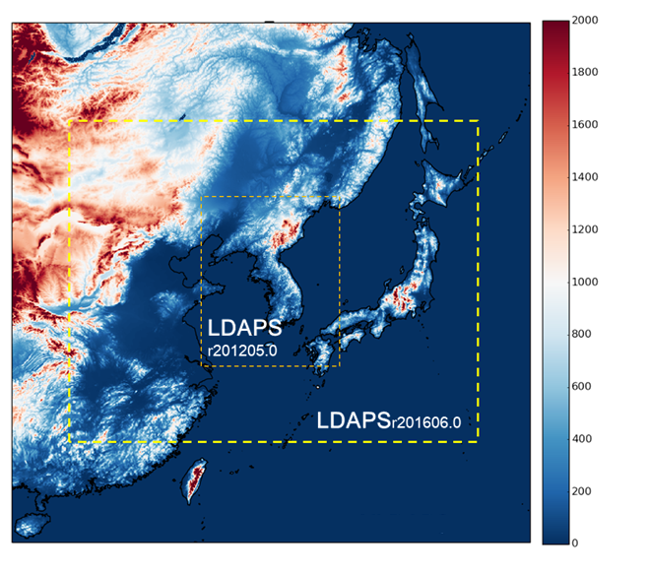
Satellite data utilization for Local Model
Impact tests of geostationary satellite data
Jung-Rim Lee
(jrleeng@korea.kr)
Atmospheric products(CSR, AMV) from geostationary satellite have been tested in the KMA local model.
- Satellite : COMS, Himawari-8
- Channel : WV channel and both of IR and WV channel for CSR
Result
  Dry biases in the upper level relieved more when adding IR CSR
  Forecast error(low atmosphere) is decreased by adding WV CSR over low clouds.
  Wind analysis improved compared with sonde - positive impact on the short range forecast with AMV(Himawari-8).
Assimilation of both clear and cloudy information resulted in reducing forecast error for all variables and levels.

Slide 11
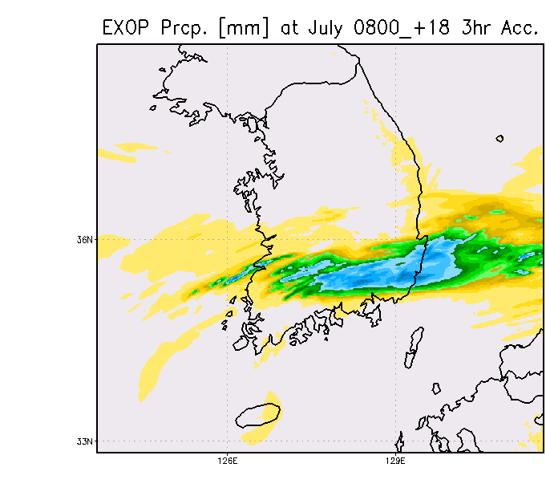
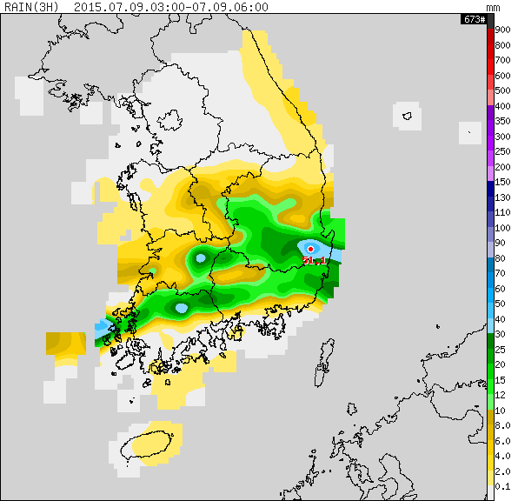
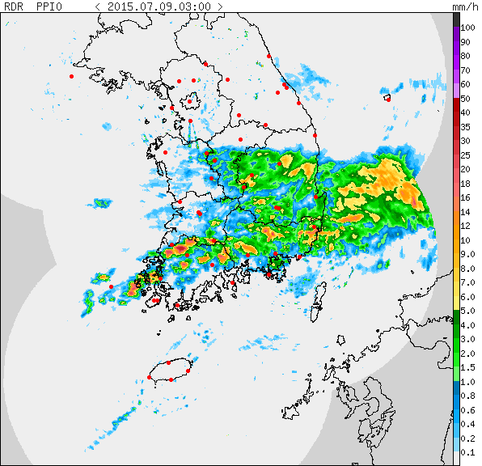
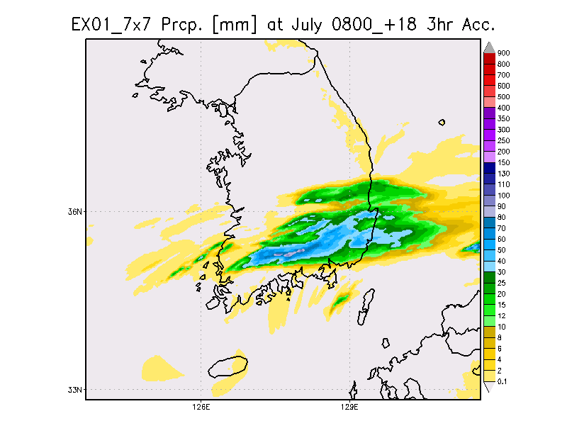
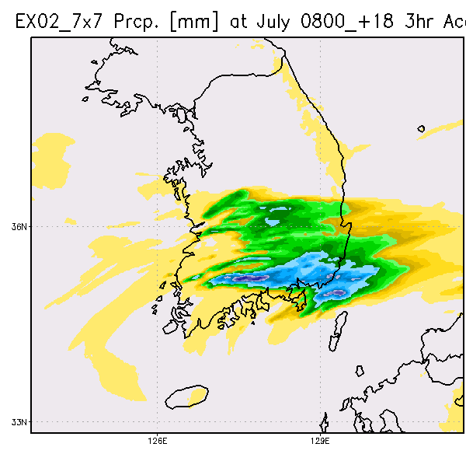
> COMS CSR
Satellite data utilization for Local Model
Jung-Rim Lee
(jrleeng@korea.kr)
Precipitation(3 hours accumulation (mm))
Impact on forecast
Rain gauge
OPER
(without CSR)
Radar
WV
WV+IR
The operational model
forecasted the rain band
too narrow.
By adding CSR data, the
rain band became broader.

Slide 12
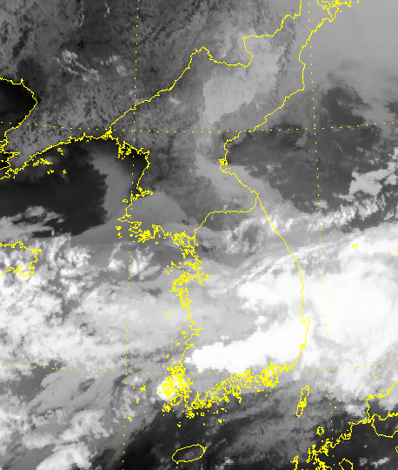
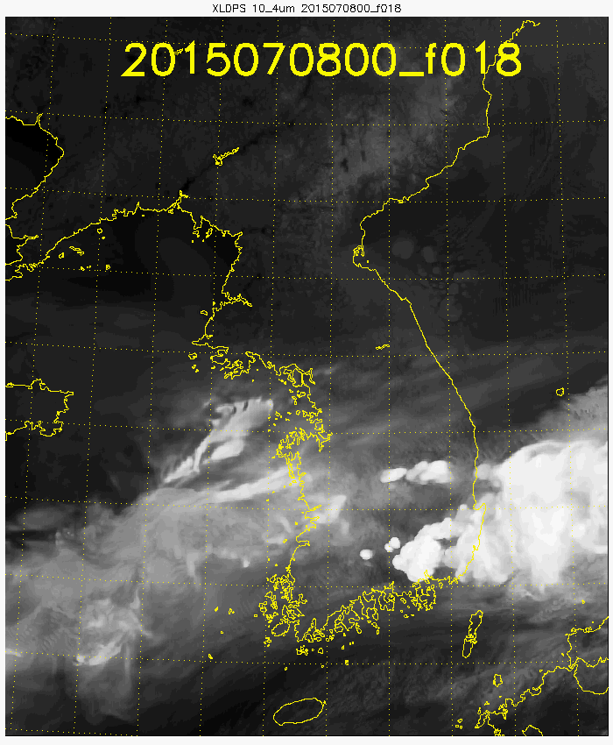
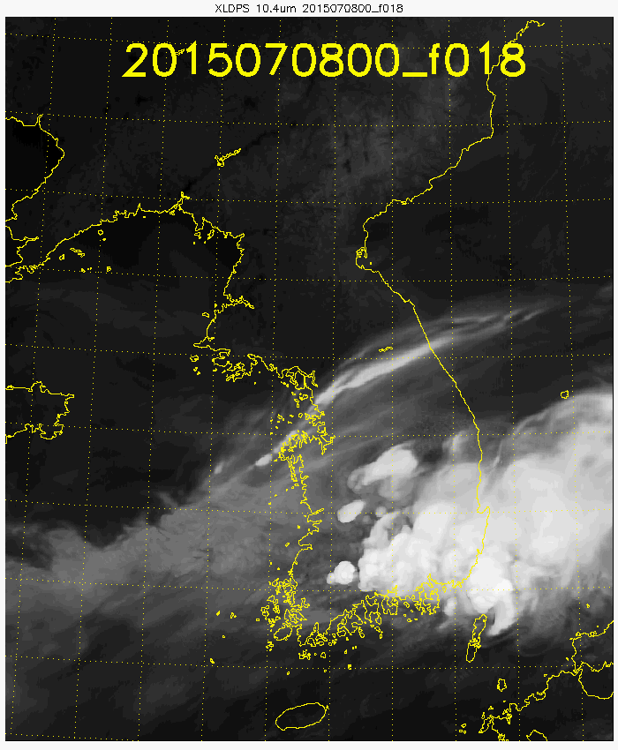
> COMS CSR
Satellite data utilization for Local Model
Jung-Rim Lee
(jrleeng@korea.kr)
Simulated satellite Imagery using the model forecast
Observation (Himawari-8)
Simulation(OPER, without CSR)
Simulation(WV+IR)
The operational model forecasted the cloud too small
The heavy rain cloud can be simulated more realistically, and cloud band
with cirrus newly produced by using COMS CSR

Slide 13
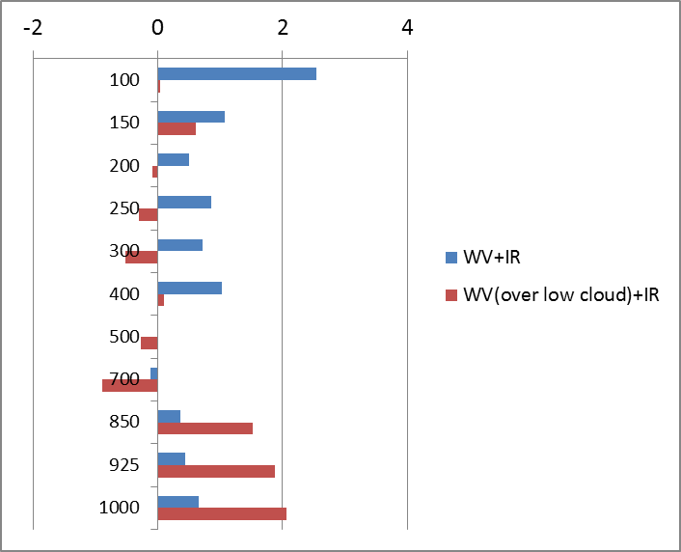
> Himawari-8 CSR
Satellite data utilization for Local Model
Jung-Rim Lee
(jrleeng@korea.kr)
Verification against ECMWF
  Improvement rate of forecast RMSE (%)
(hPa)
Overally, CSR is very positive to
the forecast
By adding WV over low clouds,
forecast error reduced in the low
atmosphere
Positive

Slide 14
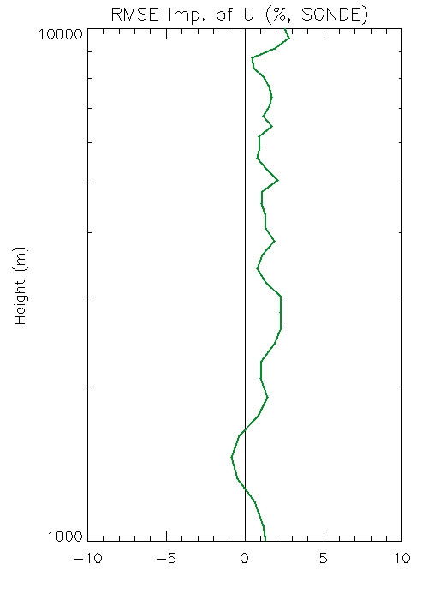
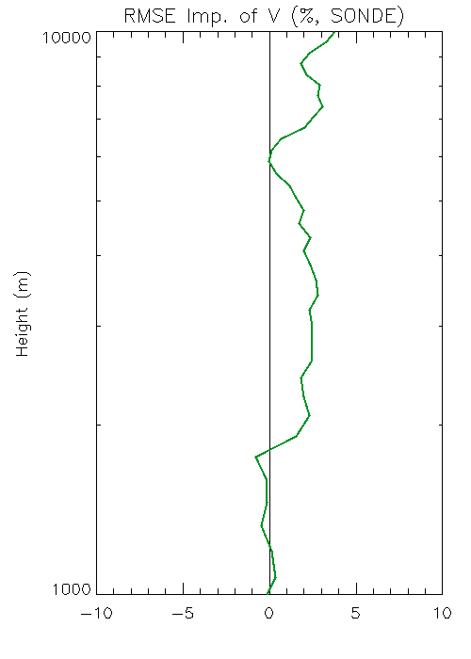
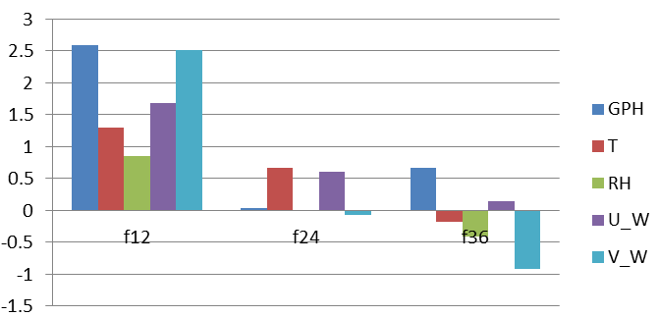
> Himawari-8 AMV
Satellite data utilization for Local Model
Jung-Rim Lee
(jrleeng@korea.kr)
Impact of Himawari-8 AMV
  VIS, IR and WV (only cloudy, 6.8 ㎛)
Improvement rate of Forecast RMSE (%), against ECMWF
O-B reduction
Positive
(m)
Forecast hour
Wind in the background fields
improved (O-B reduced)
Forecast error decreased
especially for the early forecast
time
  * Background fit of radio sonde observation

Slide 15
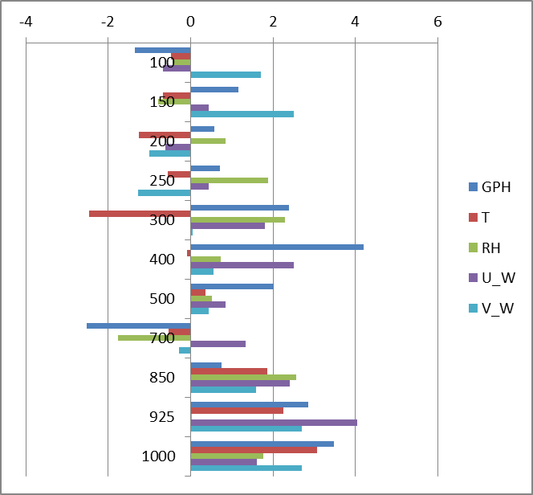
> Experiment with both CSR and AMV(Himawari-8)
Satellite data utilization for Local Model
Jung-Rim Lee
(jrleeng@korea.kr)
Verification against ECMWF
  Improvement rate of RMSE (%), against ECMWF
Very positive to reduce
forecast error by assimilating
clear/cloudy information for
Himawari-8
(hPa)
Positive

Slide 16
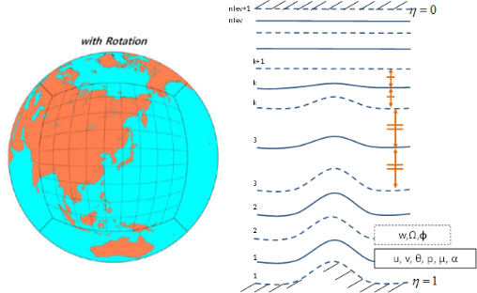
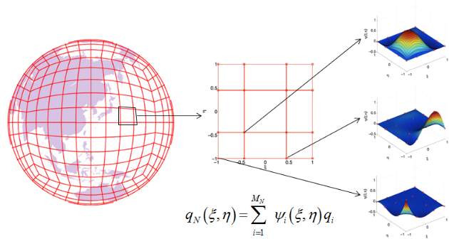
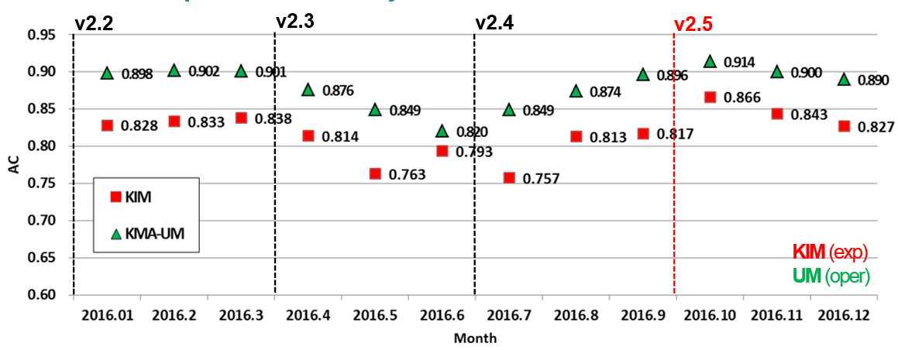

KIM Model in development
KIM(KIAPS Integrated Model)
  aimed for global model and will be operated from 2020(planed)
  Cubed sphere grid and Non-hydrostatic dynamical core
  Performance is 93% of operational model in anomaly correlation.
KIM Global
Resolution
NE240L50(~12km)
Target Length : 240hrs
Initialization : KPOP
4DEnVAR
(50 members)
500 hPa Geopotential Annomaly Corelation for NH(+120h)
KPOP
DA system for KIM
4DEnVAR(50 member)
include VARBC
KIAPS

Slide 17
Data distribution & BUFR migration
Current Status
Data spices | TAC | BUFR | Bulletin Header Name(BUFR)
SYNOP | O | O(2016. 5.~) | ISMC01, ISIC20(South Korea)
SHIP | O | O(2016. 5.~) | ISSC01
BUOY | O | O(2016. 5.~) | IOBC[19,41]
ARGO | O | O(2016. 5.~) | IOPX02
SONDE | O | O(2016. 5.~) | IUSC[01~06], IUKC[02~06](South Korea) IUKN40, IUSN40(Arctic sea) IUKK[01,02](Antarctic)
AMDAR |  | O | IUA[B,C,F,G,X]01
SAREP/SATOB |  | O | COMS AMV IUCN[01~80)

Slide 18
Satellite Activities

Slide 19


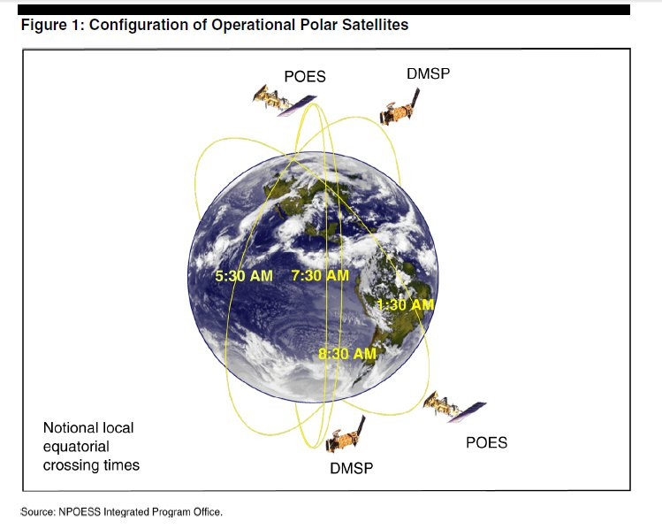

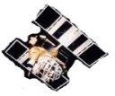


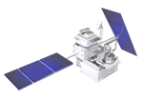


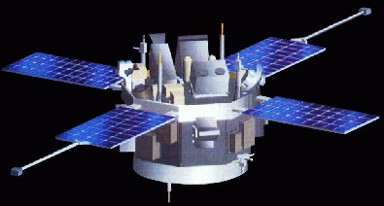

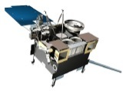
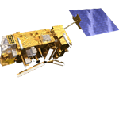
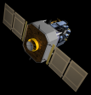

The status of satellite data reception of NMSC
Himawari-8
COMS(GOCI)
COMS (MI)
DMSP(SSM/I)
FY-2E
Windsat
S-NPP
GCOM-W1
GPM
Terra/Aqua
National Meteorological Satellite Center
ACE
NOAA-15/18/19
Direct Receiving
FTP
GOES
Metop-A/B
Direct Reception : 10 Satellites
Land-Line : 10 Satellites
SOHO
STEREO
Space Weather
GEO | COMS, HIMAWARI-8, FY-2E
LEO | NOAA-15/18/19 , Terra/Aqua, Metop-A/B, S-NPP DMSP(SSM/I), CORIOLIS, GPM, GCOM-W1 (Planned) Megha-Tropiques/SAPHIR, FY-3C/MWHS-2, MWRI

Slide 20

Update of satellite data exchange via DBNet
AP-RARS connectivity
Papeete
Toulouse
Hong Kong
IASI Radiance
(Dec. 2016)
Singapore
Jincheon
Asia-pacific regional RARS center
Metop ATOVS from Syowa site
(Sep. 2016)
Fiji
Melbourne
Tokyo
Beijing
Guangzhou
Urumuqi
Crib Point1
Darwin
Perth
Townsville
Casey
Davis
Kiyose
Syowa
Exeter
Washington
Kelburn
Maupuia
New Delhi
Chennai

Slide 21
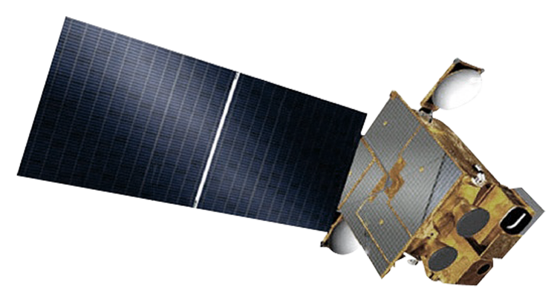


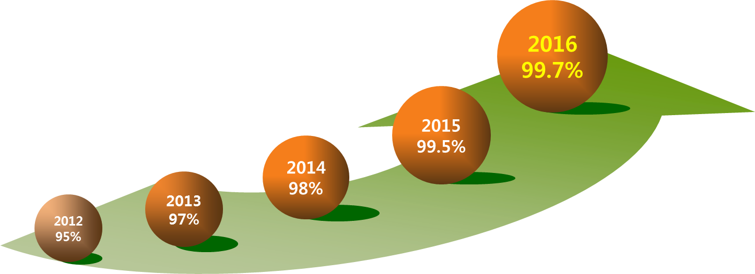
COMS
COMS(GK-1) is the first multi-purpose geostationary satellite for Korea in the application of Meteorology, Ocean and Communication
    Meteorological Mission : Continuous Observation to support weather forecasting
    and early detection of severe weather phenomena
    Period : 2003 - 2010 (8 yrs)
    Orbit : 128.2°E over equator (36,000 km)
    Design life : 7 years
    Operation : April 2011 -
Solar Panel
Ka-band Antenna
Meteorological
Imager
Communication, Ocean and
Meteorological Satellite
COMS Operation Performance (%)
GOCI

Slide 22

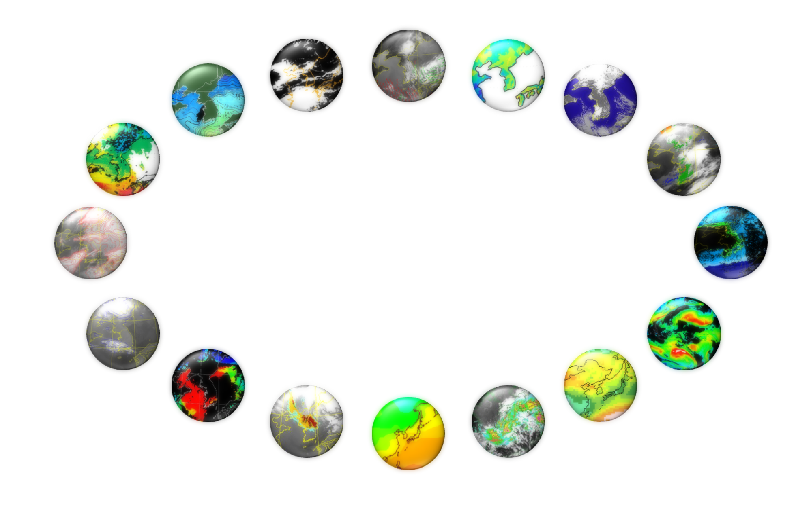
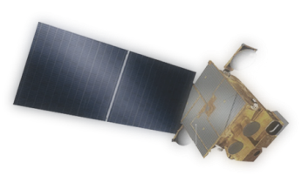
COMS Meteorological Products
16 Baseline Products are in operation (Apr. 2011-)
AMV
(Atmospheric Motion Vector)
CLD
(Cloud Detection)
LST
(Land Surface Temperature)
SSI
(Snow/Sea Ice)
SST
(Sea Surface Temperature)
TPW
(Total Precipitable Water)
Fog
CTT/CTH
(Cloud Top Temperature/Height)
UTH
(Upper Tropospheric Humidity)
COMS
CA
(Cloud Analysis)
CSR
(Clear Sky Radiance)
AOD
(Aerosol Optical Depth)
INS
(Insolation)
AI
(Aerosol Index)
OLR
(Outgoing Longwave Radiation)
RI
(Rain Intensity)
New Delhi
Chennai
http://nmsc.kma.go.kr

Slide 23
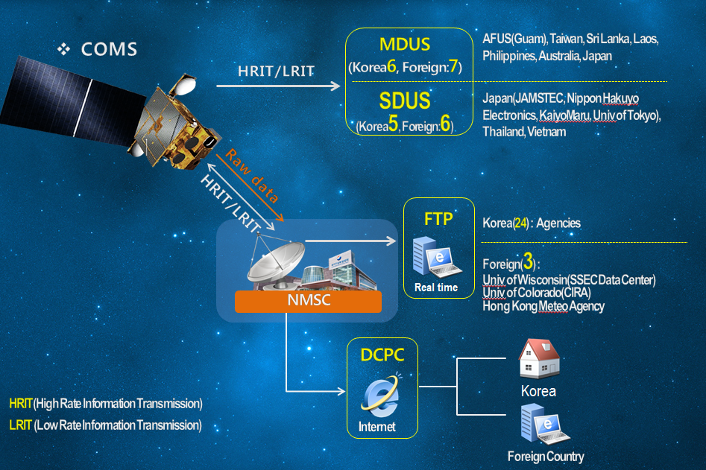
COMS Data Distribution
MDUS
(Korea10, Foreign8)
SDUS
(Korea4, Foreign6)
http://dcpc.nmsc.kma.go.kr

Slide 24
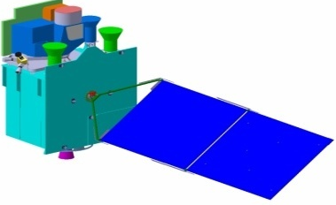
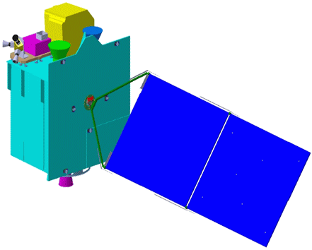
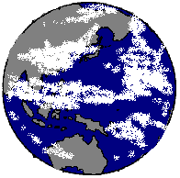

Geo-KOMPSAT-2A Program
GK-2A for the next generation Meteorological Imager and SWx monitoring
GK-2B for the Ocean Color and Atmospheric Trace Gas monitoring
KMA
Meteorological Sensor
Space weather Sensor
Geo-KOMPSAT-2A
(May, 2018)
Geo-KOMPSAT-2B
(Dec. 2018)
Ocean /
Environmental Sensor
Ground Segment
Data Processing System
GK-2A Data Service plan
[Via Satellite] Broadcast all 16 channels data of GK-2A meteorological observations
[Via Landline] Web-based data service system will be operated

Slide 25
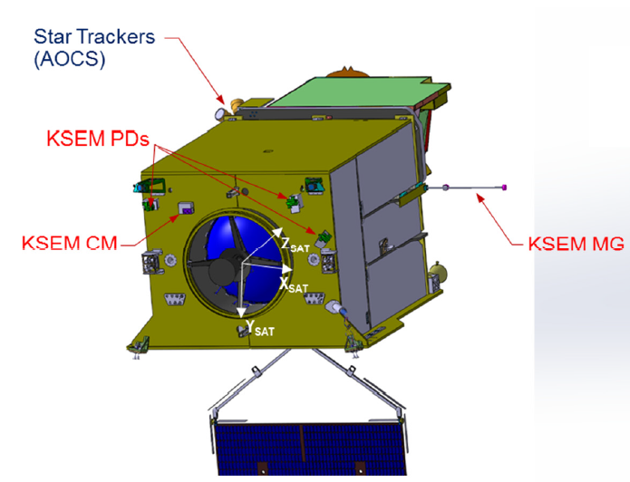
Geo-KOMPSAT-2A Payload
AMI(Advanced Meteorological Imager)
Center wavelength (μm)
AMI (Resolution) |  | ABI | AHI
1 blue | 0.47 (1km) | 0.47 | 0.46
2 green | 0.511 (1km) |  | 0.51
3 red | 0.64 (0.5km) | 0.64 | 0.64
4 | 0.856 (1km) | 0.865 | 0.86
5 | 1.38 (2km) | 1.378
6 | 1.61 (2km) | 1.61 | 1.6
 |  | 2.25 | 2.3
7 | 3.830 (2km) | 3.90 | 3.9
8 | 6.241 (2km) | 6.185 | 6.2
9 | 6.952 (2km) | 6.95 | 7.0
10 | 7.344 (2km) | 7.34 | 7.3
11 | 8.592 (2km) | 8.50 | 8.6
12 | 9.625 (2km) | 9.61 | 9.6
13 | 10.403 (2lkm) | 10.35 | 10.4
14 | 11.212 (2km) | 11.2 | 11.2
15 | 12.364 (2km) | 12.3 | 12.3
16 | 13.31 (2km) | 13.3 | 13.3
vs. AHI
- addition 1.38 μm (NIR)
- subtraction 2.3 μm (NIR)
1.38 μm : favorable for cirrus cloud detection, cloud type and amount
2.3 μm : favorable for Land/cloud Properties
KSEM(Korea Space wEather Monitor)
PD : Particle Detector
MG : Magnetometer
CM : Charging Monitor

Slide 26
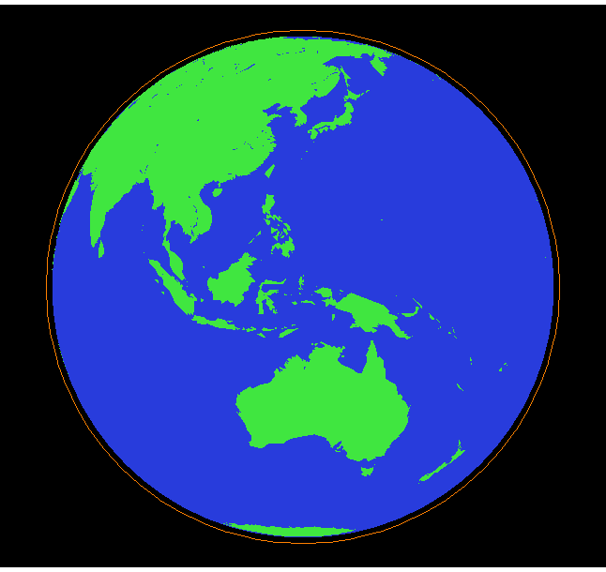

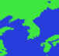
Geo-KOMPSAT-2A AMI Observation Timeline (Draft)
10 min. time slot : FD 1 + ELA 5 + LA 5
10 min.
Timeline
Full Disk
Every 10 min
ELA
Every 2 min
(3800 X 2400 km)
LA
Every 2 min
(1000 X 1000 km)
FD : Full Disk, ELA : Extended Local Area, LA : Local Area

Slide 27
Geo-KOMPSAT-2A Level 2 Products
Scene & Surface Analysis (13) | Cloud & Precipitation (14) | Aerosol & Radiation (14) | Atmospheric condition & Aviation (11)
Cloud detection | Cloud Top Temperature | Aerosol Detection | Atmospheric Motion Vector
Snow Cover | Cloud Top Pressure | Aerosol Optical Depth | Vertical Temperature Profile
Sea Ice Cover | Cloud Top Height | Asian Dust Detection | Vertical Moisture Profile
Fog | Cloud Type | Asian Dust Optical Depth | Stability Index
Sea Surface Temperature | Cloud Phase | Aerosol Particle Size | Total Precipitable Water
Land Surface Temperature | Cloud Amount | Volcanic Ash Detection and Height | Tropopause Folding Turbulence
Surface Emissivity | Cloud Optical Depth | Visibility | Total Ozone
Surface Albedo | Cloud Effective Radius | Radiances | SO₂ Detection
Fire Detection | Cloud Liquid Water Path | Downward SW Radiation (SFC) | Convective Initiation
Vegetation Index | Cloud Ice Water Path | Reflected SW Radiation (TOA) | Overshooting Top Detection
Vegetation Green Fraction | Cloud Layer/Height | Absorbed SW Radiation (SFC) | Aircraft Icing
Snow Depth | Rainfall Rate | Upward LW Radiation (TOA)
Current | Rainfall Potential | Downward LW Radiation (SFC)
 | Probability of Rainfall | Upward LW Radiation (SFC)
* Blue: Primary Products
27

Slide 28
Current status of LEO Satellite Project
Plan
research
2015-16
User requirement of LEO satellite
- Prepare report for feasibility test
- two projects are started.
Secure
a budget
2017
Feasibility study for LEO satellite (Dec 2016 ~ Sep 2017)
- Execute the feasibility study for securing budget for LEO satellite
including technical and economical validity
Development of the LEO satellite
- Kick-off development of LEO satellite program
- Satellite bus, system integration and developing testing technique
- Ground segments development and secure a image quality technique
Satellite
development
2018-
Launch
/Utilization
2022-
Application of data Utilization plan
- Apply to weather, climate, earthquake, volcano, disaster, etc.
- Data utilization research for global water/climate, etc.
- Supply standard input data of numerical model

Slide 29
Current status of LEO Satellite Project
Development (plan) : ~ 2022
Altitude/orbit : ~800km / Sun-synchronous, dawn-dusk orbit
Satellite : ~500kg, instrument : ~150kg
Proposed Instrument : MW Sounder (ATMS-like)
~ one or two instrument due to the weight of payloads(~150kg)
International cooperation / joint development for payload and sensors

Slide 30
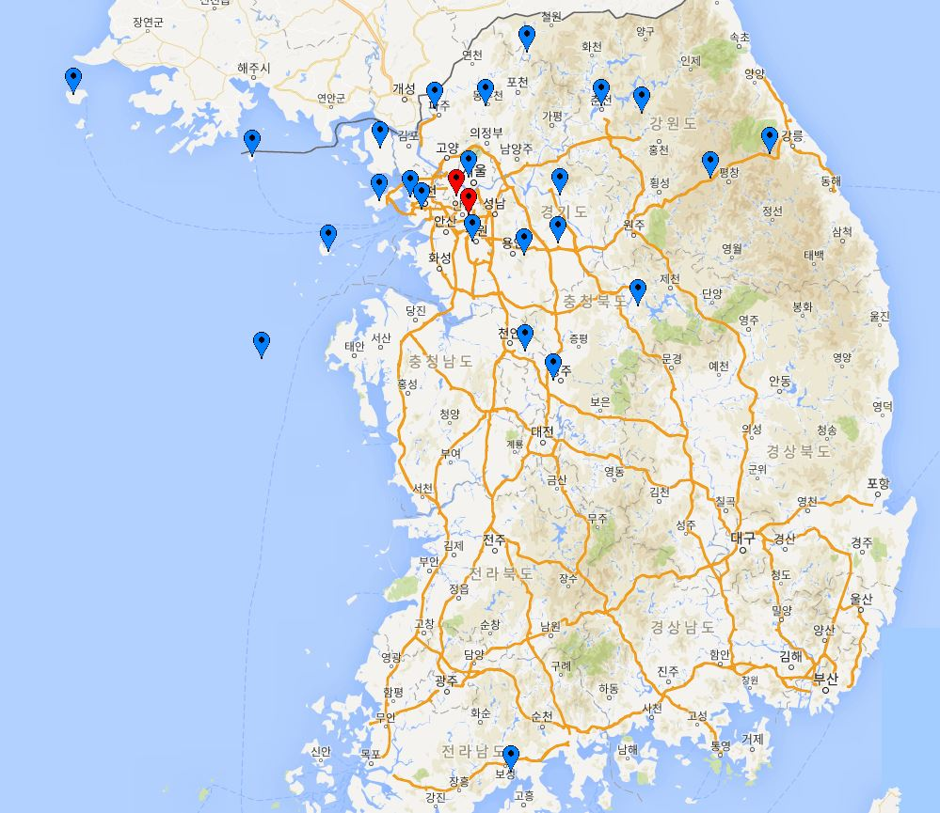
KMA Ground GNSS Operation
22 sites are being operated and hourly ZTD & RINEX are provided to NWP and Earthquake team of KMA in near-real time
2 sites (red marks) will be operated in 2nd half of 2017
Plan to broadcast Ground GNSS data(BUFR) via GTS in 2018

Slide 31
Action Items related with KMA

Slide 32
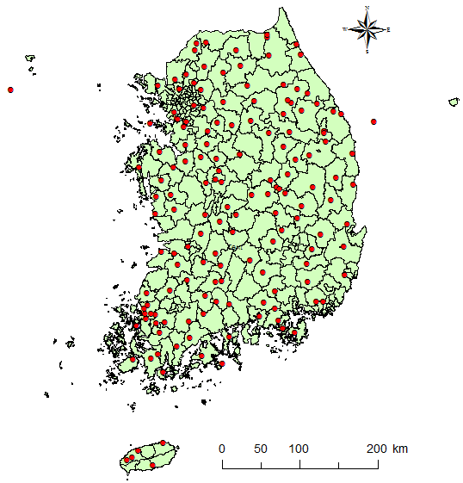
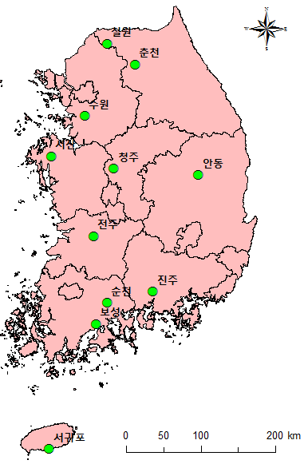
Action Items
N.4.7 All Centres to investigate putting soil temperature and moisture observations on the GTS. ACTION: All Centres
Response : KMA is still not ready to put those data on the GTS yet due to the data quality issue.
Current Status
- soil temperature obs. : 74 sites of KMA
- soil moisture obs. : 11 sites of KMA
158 sites of RDA (Rural Development Administration)
Soil Moisture obs. sites
11 sites managed by KMA
158 sites managed by RDA

Slide 33
Action Items
Action 2011-11-10 3.1 Wind Profiler Data: Bureau and KMA to investigate the availability of Australian and Korean wind profile data.
May 2014 Update: KMA have 8 profilers. Data are being input to NWP systems. Limited GTS bandwidth is an issue so some work is required within KMA.
Response : KMA Observation Bureau informed that the wind profiler data can be available publically after the data quality monitoring system is established.
Current Status
KMA is running 12 wind profilers and 4 of them is being used for data assimilation
GTS bandwidth has been improved to 4 Mbps from 128kbps since Jan. 2016
Bandwidth is not an issue any more.

Slide 34
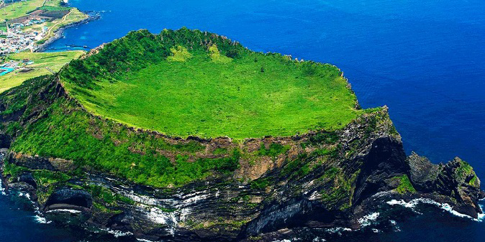
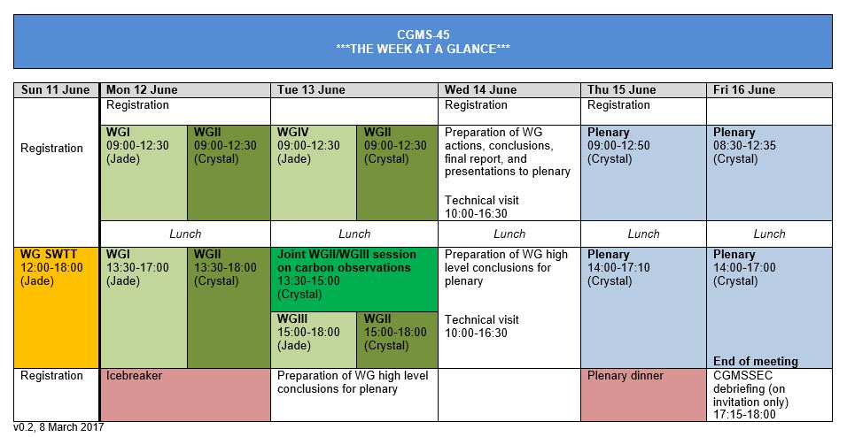
Announcements
The 45th CGMS meeting will be hosted by KMA
  11-16 June 2016,
  Maison-Glad Hotel, Jeju Island, Korea

Slide 35
THANK YOU!

